Slide 1
Text emotion detection
By
Kabilan c 312320205063
MADHESH KUMAR S 312320205078

Slide 2
content
Introduction
Sentiment analysis
Existing model
Challenges faced by existing model
Proposed System
Implementation

Slide 3
INTRODUCTION
Social networking platforms have become an essential means for communicating feelings to the entire world due to rapid expansion in the Internet era. Several people use textual content, pictures, audio, and video to express their feelings or viewpoints.
Text communication via Web-based networking media, on the other hand, is somewhat overwhelming. Every second, a massive amount of unstructured data is generated on the Internet due to social media platforms. The data must be processed as rapidly as generated to comprehend human psychology, and it can be accomplished using sentiment analysis, which recognizes polarity in texts.
It assesses whether the author has a negative, positive, or neutral attitude toward an item, administration, individual, or location. In some applications, sentiment analysis is insufficient and hence requires emotion detection, which determines an individual’s emotional/mental state precisely.

Slide 4
SENTIMENT ANALYSIS
Many people worldwide are now using blogs, forums, and social media sites such as Twitter and Facebook to share their opinions with the rest of the globe. Social media has become one of the most effective communication media available. As a result, an ample amount of data is generated, called big data, and sentiment analysis was introduced to analyze this big data effectively and efficiently .It has become exceptionally crucial for industry or organization to comprehend the sentiments of the user. Sentiment analysis, often known as opinion mining, is a method for detecting whether an author’s or user’s viewpoint on a subject is positive or negative.

Slide 5
EMOTION DETECTION
Emotions are an inseparable component of human life. These emotions influence human decision-making and help us communicate to the world in a better way. Emotion detection, also known as emotion recognition, is the process of identifying a person’s various feelings or emotions (for example, joy, sadness, or fury).
Researchers have been working hard to automate emotion recognition for the past few years. However, some physical activities such as heart rate, shivering of hands, sweating, and voice pitch also convey a person’s emotional state but emotion detection from text is quite hard. In addition, various ambiguities and new slang or terminologies being introduced with each passing day make emotion detection from text more challenging.
Furthermore, emotion detection is not just restricted to identifying the primary psychological conditions (happy, sad, anger); instead, it tends to reach up to 6-scale or 8-scale depending on the emotion model.

Slide 6
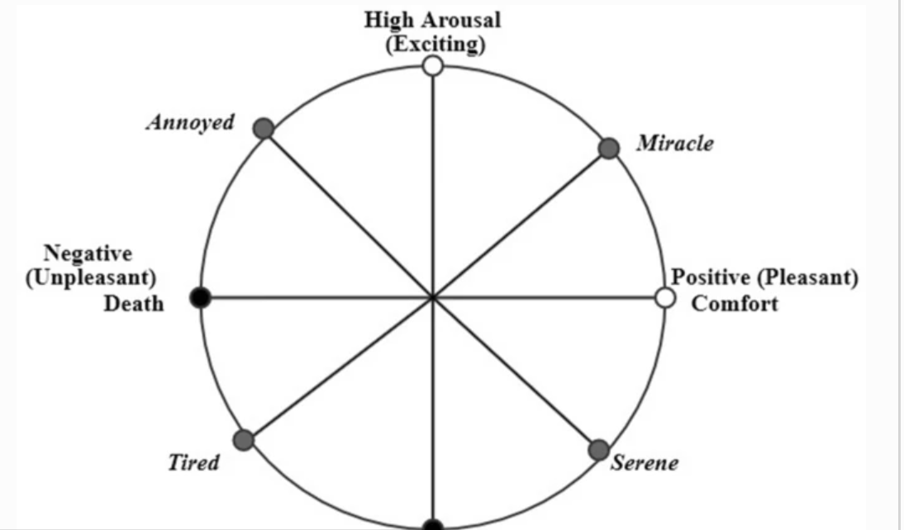
Emotion models/emotion theories
This model represents emotions based on three parameters: valence, arousal, and power. Valence means polarity, and arousal means how exciting a feeling is. For example, delighted is more exciting than happy. Power or dominance signifies restriction over emotion. These parameters decide the position of psychological states in 2-dimensional space, as illustrated in fig below

Slide 7
Categorical Emotion model
In the categorical model, emotions are defined discretely, such as anger, happiness, sadness, and fear. Depending upon the particular categorical model, emotions are categorized into four, six, or eight categories.
Depiction the numerous emotional states that can be found in various models. These states are plotted on a four-axis by taking the Plutchik model as a base model. The most commonly used emotion states in different models include anger, fear, joy, surprise, and disgust, as depicted in the figure above. It can be seen from the figure that emotions on two sides of the axis will not always be opposite of each other. For example, sadness and joy are opposites, but anger is not the opposite of fear.

Slide 8
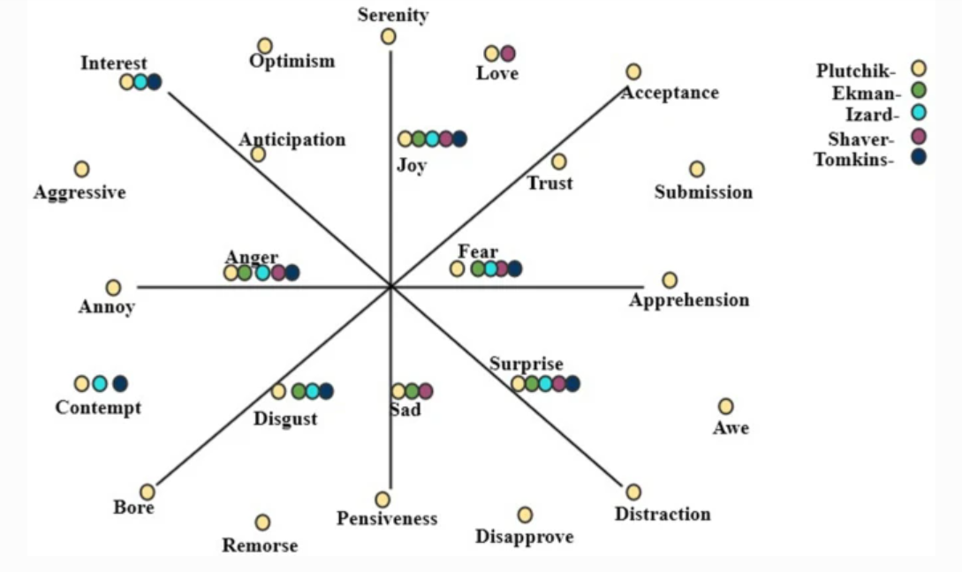
Various categories of emotion

Slide 9
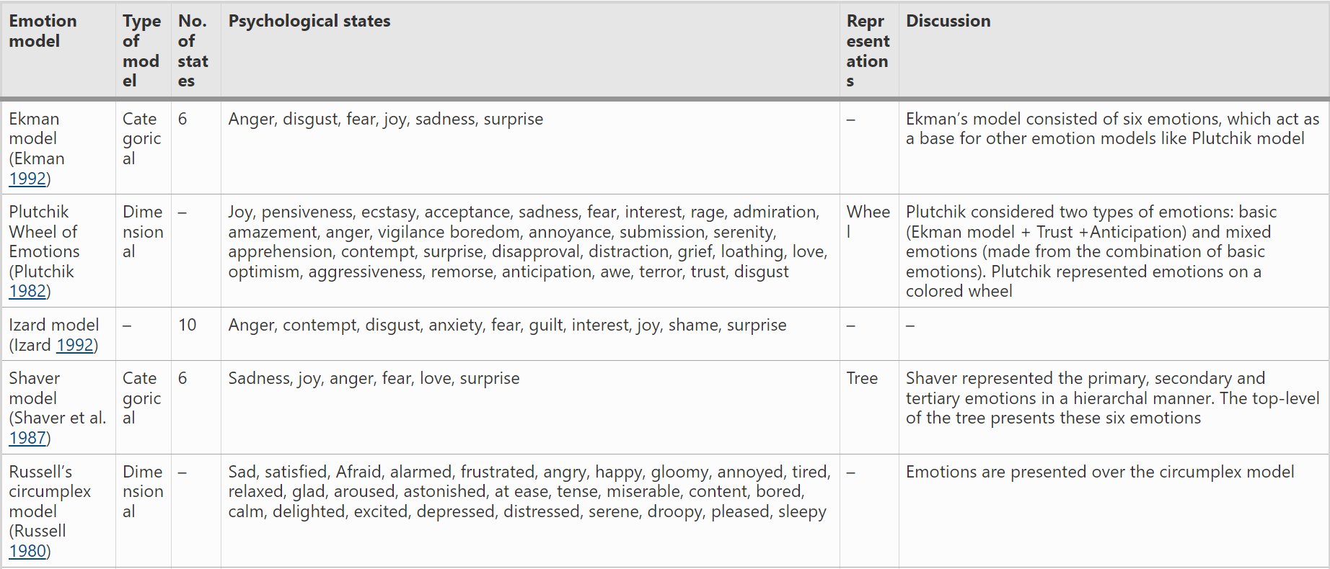
VARIOUS MODELS

Slide 10
General procedures
Identifying Input
Preprocessing of text
Feature Extraction
Model Development
Model Assesment

Slide 11
IDENTIFYING INPUT
The datasets can include mainly the tweets, reviews, feedbacks, stories, etc. A dimensional model named valence, arousal dominance model (VAD) is used in the EmoBank dataset collected from news, blogs, letters, etc. Many studies have acquired data from social media sites such as Twitter, YouTube, and Facebook and had it labeled by language and psychology experts in the literature. Data crawled from various social media platform's posts, blogs, e-commerce sites are usually unstructured and thus need to be processed to make it structured to reduce some additional computations outlined in the following section
lists numerous sentiment and emotion analysis datasets that researchers have used to assess the effectiveness of their models. The most common datasets are SemEval, Stanford sentiment treebank (SST), international survey of emotional antecedents and reactions (ISEAR) in the field of sentiment and emotion analysis. SemEval and SST datasets have various variants which differ in terms of domain, size, etc..

Slide 12
Preprocessing of text
On social media, people usually communicate their feelings and emotions in effortless ways. As a result, the data obtained from these social media platform's posts, audits, comments, remarks, and criticisms are highly unstructured, making sentiment and emotion analysis difficult for machines. As a result, pre-processing is a critical stage in data cleaning since the data quality significantly impacts many approaches that follow pre-processing .The organization of a dataset necessitates pre-processing, including tokenization, stop word removal, POS tagging, etc.
Tokenization is the process of breaking down either the whole document or paragraph or just one sentence into chunks of words called tokens .For instance, consider the sentence “this place is so beautiful” and post-tokenization, it will become 'this,' "place," is, "so," beautiful.’ It is essential to normalize the text for achieving uniformity in data by converting the text into standard form, correcting the spelling of words, etc.

Slide 13
Unnecessary words like articles and some prepositions that do not contribute toward emotion recognition and sentiment analysis must be removed. For instance, stop words like "is," "at," "an," "the" have nothing to do with sentiments, so these need to be removed to avoid unnecessary computations POS tagging is the way to identify different parts of speech in a sentence. This step is beneficial in finding various aspects from a sentence that are generally described by nouns or noun phrases while sentiments and emotions are conveyed by adjectives .
Stemming and lemmatization are two crucial steps of pre-processing. In stemming, words are converted to their root form by truncating suffixes. For example, the terms "argued" and "argue" become "argue." This process reduces the unwanted computation of sentence .Lemmatization involves morphological analysis to remove inflectional endings from a token to turn it into the base word lemma .For instance, the term "caught" is converted into "catch" .The authors concluded that removing numbers and lemmatization enhanced accuracy, whereas removing punctuation did not affect accuracy.

Slide 14
Feature extraction
The machine understands text in terms of numbers. The process of converting or mapping the text or words to real-valued vectors is called word vectorization or word embedding. It is a feature extraction technique where in a document is broken down into sentences that are further broken into words; after that, the feature map or matrix is built. In the resulting matrix, each row represents a sentence or document while each feature column represents a word in the dictionary, and the values present in the cells of the feature map generally signify the count of the word in the sentence or document.
To carry out feature extraction, one of the most straightforward methods used is 'Bag of Words' (BOW), in which a fixed-length vector of the count is defined where each entry corresponds to a word in a pre-defined dictionary of words. The word in a sentence is assigned a count of 0 if it is not present in the pre-defined dictionary, otherwise a count of greater than or equal to 1 depending on how many times it appears in the sentence. That is why the length of the vector is always equal to the words present in the dictionary. The advantage of this technique is its easy implementation but has significant drawbacks as it leads to a sparse matrix, loses the order of words in the sentence, and does not capture the meaning of a sentence For example, to represent the text “are you enjoying reading” from the pre-defined dictionary I, Hope, you, are, enjoying, reading would be (0,0,1,1,1,1). However, these representations can be improved by pre-processing of text and by utilizing n-gram, TF-IDF.

Slide 15
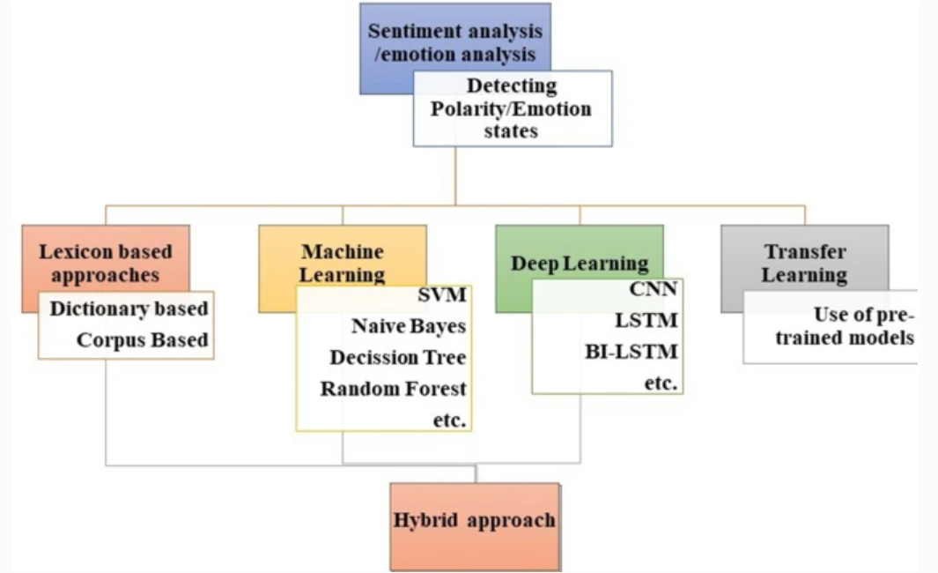
Techniques for emotion detection
various techniques for sentiment analysis and emotion detection which are broadly classified into a lexicon-based approach, machine learning-based approach, deep learning-based approach. The hybrid approach is a combination of statistical and machine learning approaches to overcome the drawbacks of both approaches.

Slide 16
EMOTION DETECTION techniques
Lexicon-based Approach
Its a keyword-based search approach that searches for emotion keywords assigned to some psychological states .The popular lexicons for emotion detection are WordNet-Affect and NRC word–emotion lexicon .WordNet-Affect is an extended form of WordNet which consists of affective words annotated with emotion labels. NRC lexicon consists of 14,182 words, each assigned to one particular emotion and two sentiments. These lexicons are categorical lexicons that tag each word with an emotional state for emotion classification.
However, by ignoring the intensity of emotions, these traditional lexicons become less informative and less adaptable. Generally, researchers generate their lexicons and directly apply them for emotion analysis, but lexicons can also be used for feature extraction purposes. lexicon was created by increasing the number of words in the NRC emotion lexicon and semi-automatic translation using six online translators. Those entries obtained from at least three translators were considered pre-validated and then validated by the manual translator.

Slide 17
Machine Learning-based Techniques
Emotion detection or classification may require different types of machine learning models such as Naïve Bayes, support vector machine, decision trees, etc.Extracted the emotions from multilingual texts collected from three different domains. The authors used a novel approach called rich site summary for data collection and applied SVM and Naïve Bayes machine learning algorithms for emotion classification of twitter text.
Deep Learning and Hybrid Technique
Deep learning area is part of machine learning that processes information or signals in the same way as the human brain does. Deep learning models contain multiple layers of neurons. Thousands of neurons are interconnected to each other, which speeds up the processing in a parallel fashion. These representations are then concatenated and then passed to a mesh network for classification.

Slide 18
Model assessment
The model is compared with baseline models based on various parameters. There is a requirement of model evaluation metrics to quantify model performance. A confusion matrix is acquired, which provides the count of correct and incorrect judgments or predictions based on known actual values. This matrix displays true positive (TP), false negative (FN), false positive (FP), true negative (TN) values for data fitting based on positive and negative classes. Based on these values, researchers evaluated their model with metrics like accuracy, precision, and recall, F1 score, etc.,

Slide 19
DRAWBACK OF EXISTING MODEL
In the Internet era, people are generating a lot of data in the form of informal text. Social networking sites present various challenges which includes spelling mistakes, new slang, and incorrect use of grammar. These challenges make it difficult for machines to perform sentiment and emotion analysis. Sometimes individuals do not express their emotions clearly. For instance, in the sentence “Y have u been soooo late?”, 'why' is misspelled as 'y,' 'you' is misspelled as 'u,' and 'soooo' is used to show more impact. Moreover, this sentence does not express whether the person is angry or worried. Therefore, sentiment and emotion detection from real-world data is full of challenges due to several reasons
One of the challenges faced during emotion recognition and sentiment analysis is the lack of resources. For example, some statistical algorithms require a large annotated dataset. However, gathering data is not difficult, but manual labeling of the large dataset is quite time-consuming and less reliable .
The other problem regarding resources is that most of the resources are available in the English language. Therefore, sentiment analysis and emotion detection from a language other than English, primarily regional languages, are a great challenge and an opportunity for researchers. Furthermore, some of the corpora and lexicons are domain specific, which limits their re-use in other domains.

Slide 20
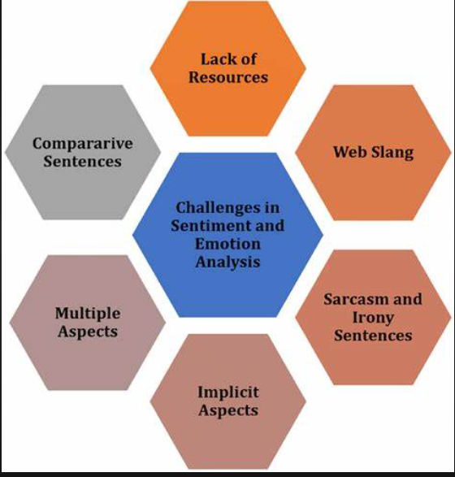

Slide 21
CONCLUSION
It has been analyzed that the lexicon-based technique performs well in both sentiment and emotion analysis. However, the dictionary-based approach is quite adaptable and straightforward to apply, whereas the corpus-based method is built on rules that function effectively in a certain domain. As a result, corpus-based approaches are more accurate but lack generalization. Machine learning is suitable to overcome old method especially Support Vector Machine, especially the liner svm model, are prevalent in sentiment and emotion analysis, as they can cover long-term dependencies and extract features very well and also produces accuracy above 60 percent but depending on the dataset.

Slide 22
IMPLEMENTATION

